Slide 1


SQL for Excel Users

Slide 2

Objectives for this course
The basics of relational databases and SQL’s role
The foundational commands used for reading form one or more tables in a database
Schemas, primary keys and foreign keys: what makes relational databases “relational.”

Slide 3
Augment your Excel skills
Use SQL to query a database to extract useful information
Explore basic commands and functions of SQL
Extract data and work with queries to pull the data you need for your analysis

Slide 4
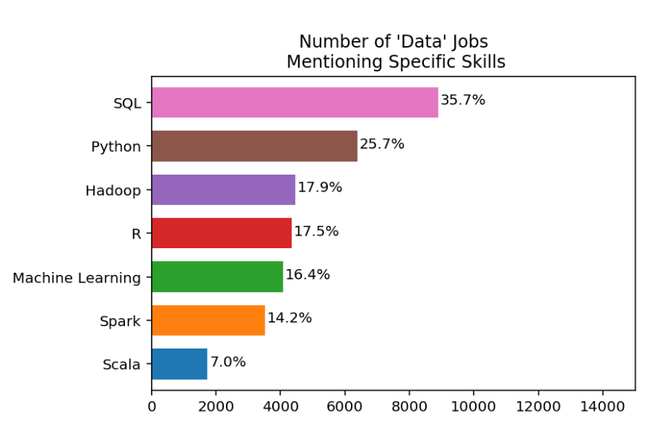
I’m guessing you want work
https://www.dataquest.io/blog/why-sql-is-the-most-important-language-to-learn/

Slide 5

Cross-train your data brain

Slide 6
From using Excel to using SQL

Slide 7
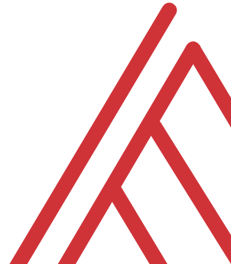
What is a spreadsheet and when would you use it?
Good for…
Browsing data
Entering/editing data
Flexible data structuring
Quick, visual data analysis on small datasets
Not so much at…
Archiving data
Big data
Interfacing data
Structured data across multiple datasets

Slide 8






Relational databases
1970s origins…
Still with us today!

Slide 9

Meet your librarian
Structured
Query
Language

Slide 10

Are you ready for some baseball?
Lahman database: complete player statistics since 1871 plus salaries, Hall of Fame inductions and more!
Download here for SQLite

Slide 11

Onward to SQLite!
+

Slide 12

ARE YOU READY FOR SOME DRILLS?
How many columns are in Managers?
How many of these columns are of type INTEGER?
How many rows does Managers have?

Slide 13
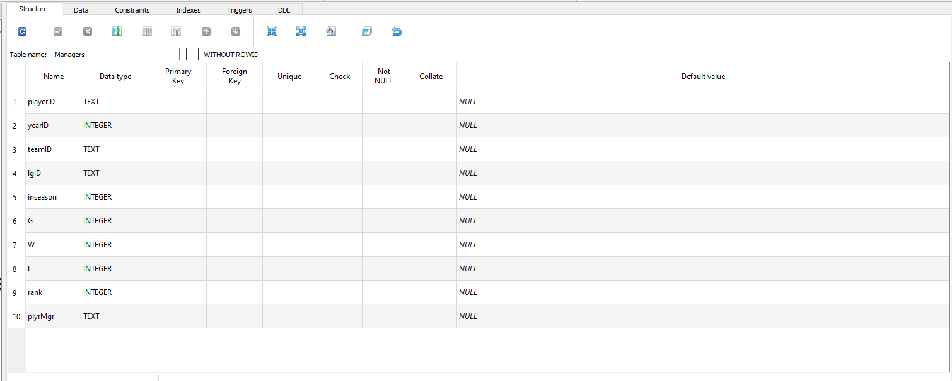
How many columns are in Managers?

Slide 14
2. How many of these columns are of type INTEGER?

Slide 15
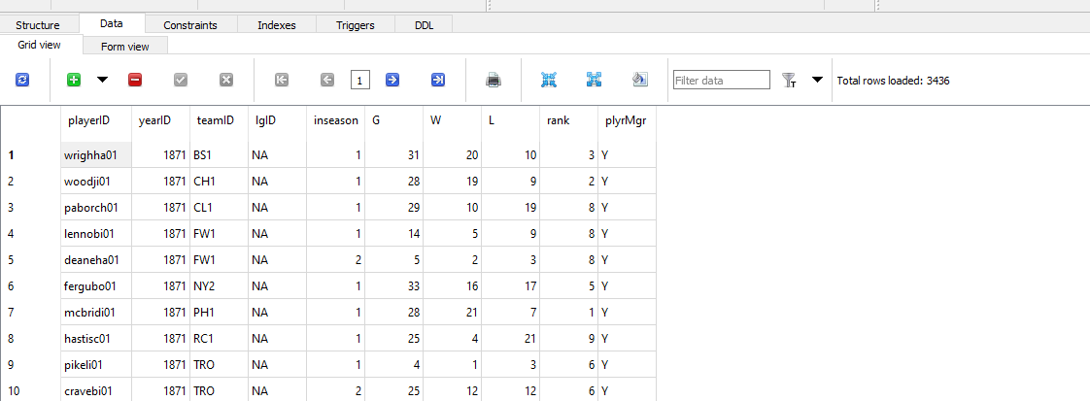
3. How many rows does Managers have?

Slide 16
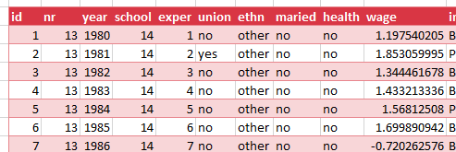
Look to the table
Field/column/attribute
Row/tuple
Value
Table

Slide 17
Questions?

Slide 18
From Excel tables to SQL SELECT

Slide 19
From Excel-ese to SQL-ese
Excel
Data
Calculations
Notes
SQL
Tables
Queries/Scripts
Comments

Slide 20
The grammar of SQL
Term | What it does | Example
Identifier | Identifies an object (i.e. table, field) | Master
Operator | Takes some action (perform calculation,, rename something) | +, AS
Expression | Applies criteria to data | birthYear > 1960

Slide 21

Stylin’ in SQL
0. Good comments starting with –
Each clause on its own line
All operators uppercase (SELECT, ORDER BY, etc.)
Statements end with semicolon (;)

Slide 22
Let’s get coding…
-- List all the tables in our database
SELECT name
FROM sqlite_master
WHERE type='table'
ORDER BY name;
--Get the name and data type from every field in the
--"master" table
PRAGMA table_info(master);

Slide 23
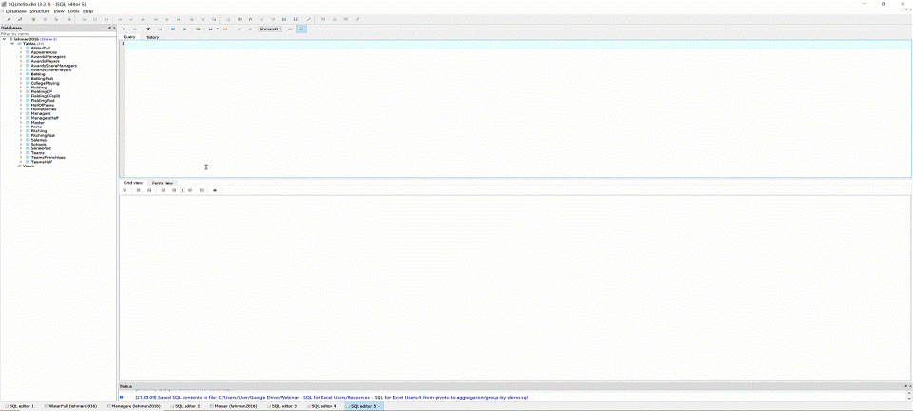
The font is too dang small!

Slide 24
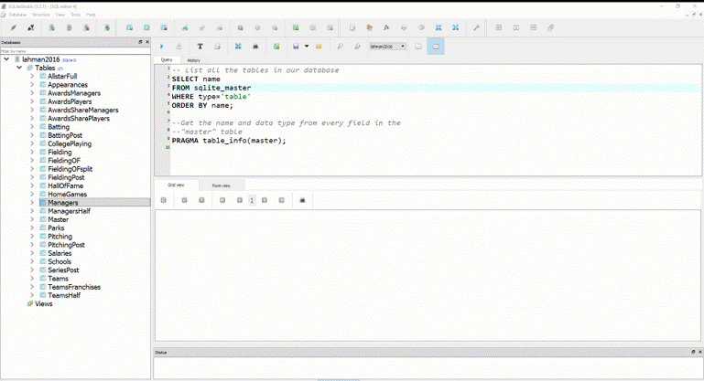
Saving your first .sql script

Slide 25
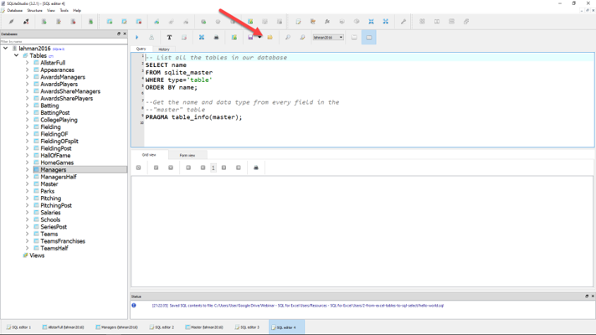
Loading your first .sql script

Slide 26
Demo: sql-tables-example.xlsx

Slide 27
The SQL reader’s digest
Term | What it does
SELECT | Which fields to look for
FROM | Where to look for those fields
WHERE | What criteria those records should meet
GROUP BY | How to aggregate the results
HAVING | What criteria the aggregated results should meet
ORDER BY | How to sort the results
LIMIT | How many records to limit results to

Slide 28
Demo: sql-select-demo.sql

Slide 29
Drills
Using the Teams table:
Select all fields.
Select all fields, first 100 rows.
Select yearID, teamID, W, L.
Select yearID, teamID, and a calculated field win_diff as the difference between W and L.
Create a field team_record such that the first record will read: 1871 Boston Red Stockings: 20-10.

Slide 30
Drills
Using the Teams table:
Select all fields.
Select all fields, first 100 rows.
Select yearID, teamID, W, L.
Select yearID, teamID, and a calculated field win_diff as the difference between W and L.
Create a field team_record such that the first record will read: 1871 Boston Red Stockings: 20-10.
Solutions: sql-select-drills.sql

Slide 31
From Sort & Filter to WHERE and ORDER BY

Slide 32
Demo: sort-filter.xlsx

Slide 33
The SQL reader’s digest
Term | What it does
SELECT | Which fields to look for
FROM | Where to look for those fields
WHERE | What criteria those records should meet
GROUP BY | How to aggregate the results
HAVING | What criteria the aggregated results should meet
ORDER BY | How to sort the results
LIMIT | How many records to limit results to

Slide 34
WHERE: Comparison operators
Operator | Description
= | Equal to
<>, != | Not equal to
> | Greater than
< | Less than
>= | Greater than or equal to
<= | Less than or equal to

Slide 35
WHERE: Logical operators
Operator | Description
BETWEEN | Between an inclusive range
IS NULL | Is a null value
IN | Specifies a range of conditions
OR | Avoids evaluating second condition if first is met
AND | Can be used with other operators
NOT | Excludes results

Slide 36
WHERE LIKE: Wildcard operators
Operator | Description
‘a%’, ‘abc%’ | Returns records that start with a, abc
‘_ _ a’,’_ _ c’ | Returns records with a in 2nd position, abc in 3rd position

Slide 37

A note on NULLs
DOES
Indicate a missing value
DOES NOT
Indicate a value of 0
Indicate why it’s missing

Slide 38
Demo: sort-filter-demo.sql

Slide 39
Drills (continues on next slide)
Using the Managers table:
Select all records, sorted newest to oldest, then by playerID alphabetically.
Select all records between the 1991 and 2000 seasons, sorted high to low by number of games, G.
Create a field, win_diff, calculated as W – L. Return the records with the 25 highest values of win_diff.
How many missing values are in the rank field?

Slide 40
Drills (continued from previous slide)
Using the Managers table:
Select all records, sorted newest to oldest, then by playerID alphabetically.
Select all records between the 1991 and 2000 seasons, sorted high to low by number of games, G.
Create a field, win_diff, calculated as W – L. Return the records with the 25 highest values of win_diff.
How many missing values are in the rank field?

Slide 41
From SUM() and SUMIF() to Aggregation

Slide 42
Demo: aggregation-demo.xlsx

Slide 43
Basic arithmetic functions
Operator | Description
SUM() | Total of records
AVG() | Average of records
MIN() | Minimum value of records
MAX() | Maximum value of records
COUNT() | Count of non-null records

Slide 44
Basic string functions
Operator | Description
CONCAT() | Concatenates fields together
LEFT() | Returns left X values from a string
RIGHT() | Returns right X values from a string
UPPER() | Returns capitalized string
LOWER() | Returns lowercased string

Slide 45
Exploring fields and records
Operator | Description
COUNT(X) | Counts all non-null records of X
DISTINCT X | Returns all distinct values of X
COUNT(DISTINCT X) | Counts distinct values of X

Slide 46
Demo: aggregation-demo.sql

Slide 47
Drills (continues on next slide)
Using the Teams table:
Select the maximum and minimum number of runs.
Select the total number of home runs between 2000 and 2010: total_homers.
Count the number of records where the games played is NULL.
Count the number of records with a recorded attendance.
Return a list of all years reflected in the table.
Count the number of unique franchises since 1915.

Slide 48
Drills (continues on next slide)
Using the Teams table:
Select the maximum and minimum number of runs.
Select the total number of home runs between 2000 and 2010: total_homers.
Count the number of records where the games played is NULL.
Count the number of records with a recorded attendance.
Return a list of all years reflected in the table.
Count the number of unique franchises since 1915.
Solutions: aggregation-drills.sql

Slide 49
From PivotTables to GROUP BY

Slide 50
Demo: group-by-demo.xlsx

Slide 51
The SQL reader’s digest
Term | What it does
SELECT | Which fields to look for
FROM | Where to look for those fields
WHERE | What criteria those records should meet
GROUP BY | How to aggregate the results
HAVING | What criteria the aggregated results should meet
ORDER BY | How to sort the results
LIMIT | How many records to limit results to

Slide 52
Demo: group-by-demo.sql

Slide 53
Drills
Using the Teams table:
Return the largest attendance for each team, sorted high to low.
Find the total number of stolen bases, grouped by year and league.
Find the average number of home runs for each season, keeping only years with an average of 150 home runs or more.

Slide 54
Drills
Using the Teams table:
Return the largest attendance for each team, sorted high to low.
Find the total number of stolen bases, grouped by year and league.
Find the average number of home runs for each season, keeping only years with an average of 150 home runs or more.
Solutions: group-by-drills.sql

Slide 55
Capstone: All clauses in one

Slide 56
The SQL reader’s digest
Term | What it does
SELECT | Which fields to look for
FROM | Where to look for those fields
WHERE | What criteria those records should meet
GROUP BY | How to aggregate the results
HAVING | What criteria the aggregated results should meet
ORDER BY | How to sort the results
LIMIT | How many records to limit results to

Slide 57


Try forgetting now…
Term | What it does
SWEATY | SELECT
FEET | FROM
WILL | WHERE
GIVE | GROUP BY
HORRIBLE | HAVING
ODORS | ORDER BY

Slide 58
Try forgetting now…
Term | What it does
SWEATY | SELECT nameFirst, COUNT(nameFirst)
FEET | FROM Master
WILL | WHERE birthCountry != ‘USA’
GIVE | GROUP BY nameFirst
HORRIBLE | HAVING COUNT(nameFirst) > 1
ODORS | ORDER BY COUNT(nameFirst) DESC;

Slide 59
Drills
Using the Teams table:
Find the maximum number of home runs hit by a team for each year since 1980. Include only those years where fewer than 200 home runs were hit by any team. Sort the results from high to low.
For NL teams that won the World Series that year, what was the maximum number of games won? Include only those teams that won at least 100 games for one of those years. Sort the results from high to low.

Slide 60
Drills
Using the Teams table:
Find the maximum number of home runs hit by a team for each year since 1980. Include only those years where fewer than 200 home runs were hit by any team. Sort the results from high to low.
For NL teams that won the World Series that year, what was the maximum number of games won? Include only those teams that won at least 100 games for one of those years. Sort the results from high to low.
Solutions: sql-all-statements-in-one-drill.sql

Slide 61
From VLOOKUP() to JOIN

Slide 62

How do we get information from more than one table at a time?
What makes a relational database, relational?
https://dev.to/helenanders26/sql-series-all-about-sql-joins-15ol

Slide 63
Demo: vlookup-vs-join.xlsx

Slide 64
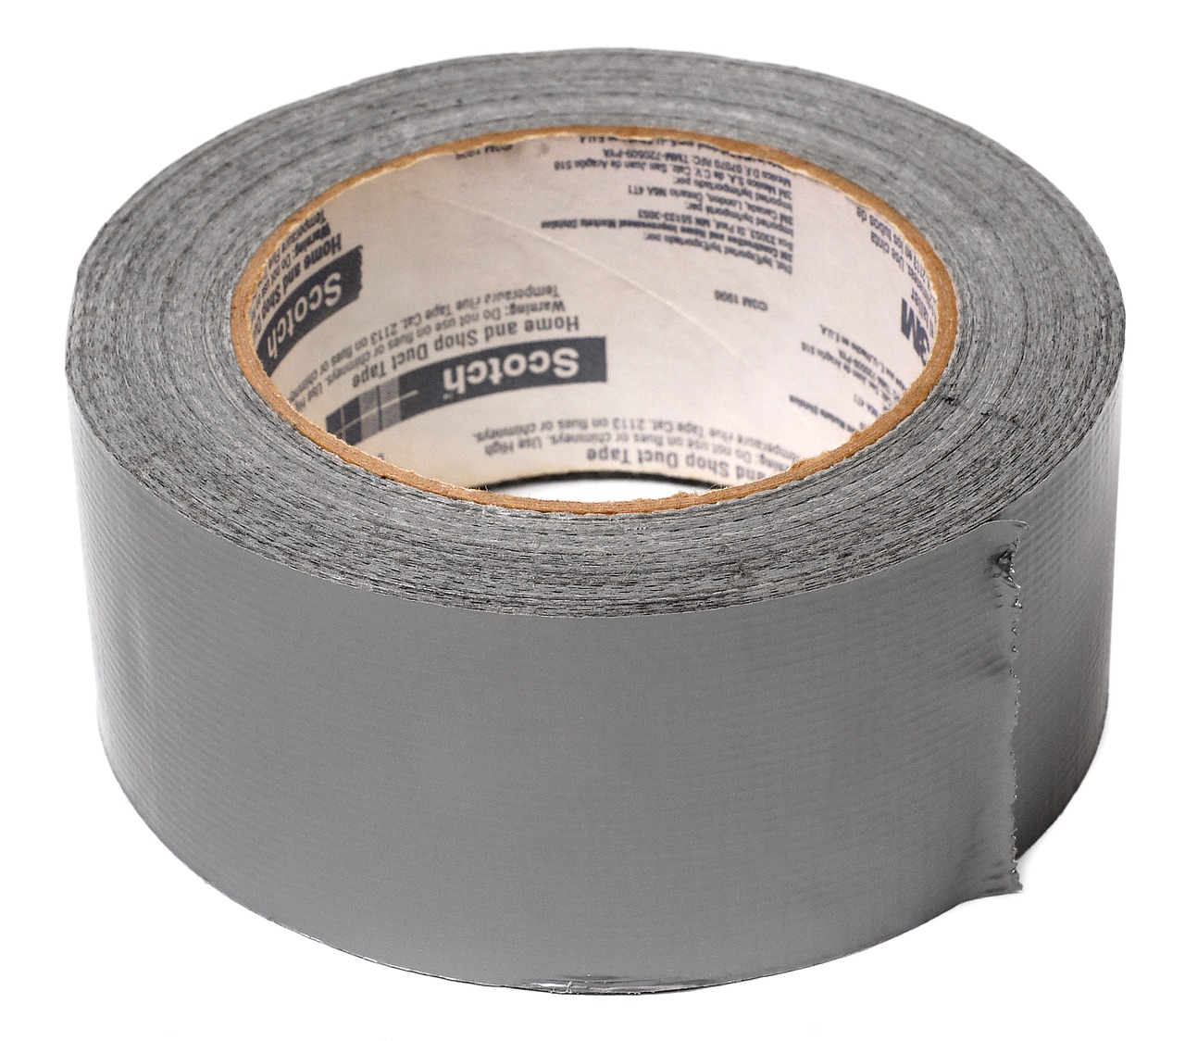

FROM VLOOKUP() Duct Tape to JOIN Blowtorch

Slide 65

Key-lookup
Primary key: Unique, unchanging identifier
Foreign key: References the primary key of another table

Slide 66

Ever been asked for your ID number?
That’s your primary key!

Slide 67
One-to-one relationship

Slide 68
One-to-many relationship

Slide 69
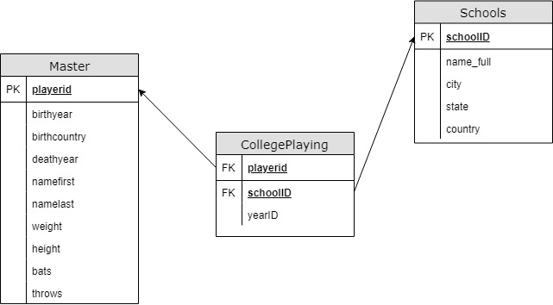
Introducing Schemas

Slide 70
INNER JOIN
Returns records with matching values in both Table A and Table B
TABLE A
TABLE B

Slide 71
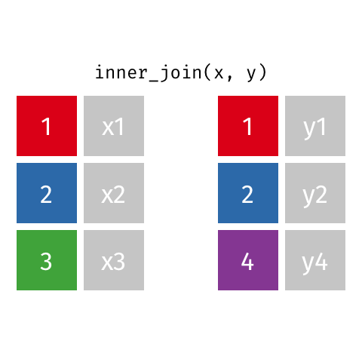
Visualizing an INNER JOIN
https://github.com/gadenbuie/tidyexplain#mutating-joins

Slide 72
Demo: inner-join-demo.sql

Slide 73
Drills
For the Master and HallOfFame tables:
Return a list of unique first and last names for all individuals in HallOfFame
Return first and last names along with the year, votes needed and votes received for all successful HoF inductees
Return the birth year of the oldest individual inducted for each year of HoF inductions. How “old” was each player at induction?

Slide 74
Drills
For the Master and HallOfFame tables:
Return a list of unique first and last names for all individuals in HallOfFame
Return first and last names along with the year, votes needed and votes received for all successful HoF inductees
Return the birth year of the oldest individual inducted for each year of HoF inductions. How “old” was each player at induction?
Solutions: inner-join-drills.sql

Slide 75
LEFT OUTER JOIN
Returns all records from Table A and matching records from Table B. NULL if no match.
TABLE A
TABLE B

Slide 76

Visualizing a LEFT OUTER JOIN
https://github.com/gadenbuie/tidyexplain#mutating-joins

Slide 77
Demo: left-outer-join-demo.sql

Slide 78
Drills
Find the maximum annual salary paid to anyone included in Master, sorted descending by salary.
Keeping the names of all schools listed in Schools, find the first name, last name and years played for all schools (Check CollegePlaying).

Slide 79
Drills
Find the maximum annual salary paid to anyone included in Master, sorted descending by salary.
Keeping the names of all schools listed in Schools, find the first name, last name and years played for all schools (Check CollegePlaying).
Solutions: left-outer-join-drills.sql

Slide 80
From “That’s hard in Excel!” to “That’s easy in SQL!”

Slide 81
Demo: hard-in-excel-easy-in-sql.xlsx

Slide 82
Demo: hard-in-excel-easy-in-sql.sql

Slide 83
CASE expressions
CASE
WHEN condition THEN result-expression
WHEN condition THEN result-expression ...
ELSE result-expression
END AS alias

Slide 84
Subqueries as condition: WHERE
SELECT fields
FROM table
WHERE operator
-- Subquery
(SELECT fields
FROM table);

Slide 85
Common table expressions (CTEs): Expressions acting like tables
WITH
expression_name_1 AS
(CTE query definition 1)
SELECT expression_A, expression_B, ...
FROM expression_name_1

Slide 86
Drills
Using the Teams table:
In 2016, what teams had more wins than the Chicago Cubs (teamID = ‘CHN’?)
Create a field Century which marks records in the 19th Century as 19, 20th as 20 and 21st as 21.
Find the average season minimum attendance since 1990.

Slide 87
Drills
Find the maximum annual salary paid to anyone included in Master, sorted descending by salary.
Keeping the names of all schools listed in Schools, find the first name, last name and years played for all schools (Check CollegePlaying).
Solutions: hard-in-excel-easy-in-sql.sql

Slide 88
SQL: The Prequel

Slide 89

Learning SQL, 2nd Edition
by Alan Beaulieu

Slide 90

SQL Cookbook
By Anthony Molinaro

Slide 91
Find me
georgejmount.com
@gjmount
github.com/summerofgeorge

Slide 92
Thank you

